Slide 1
Cloud Computing Lab 3
Phoebe Wu

Slide 2
Part I

Slide 3
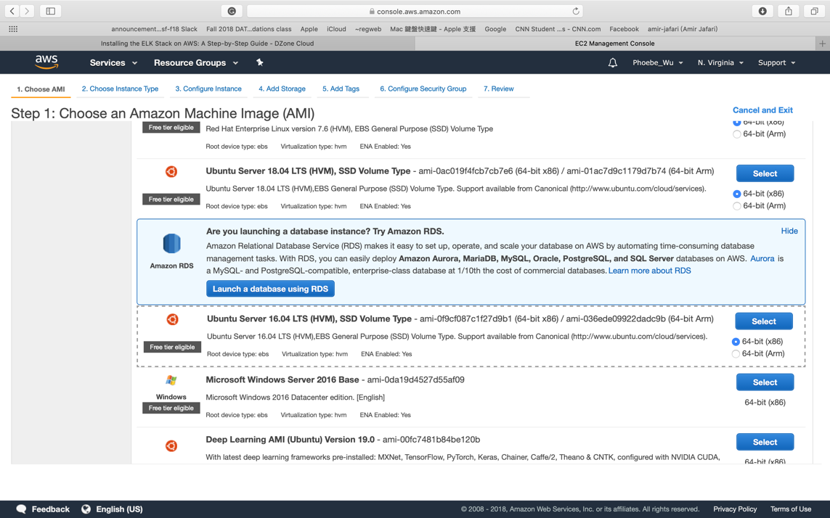
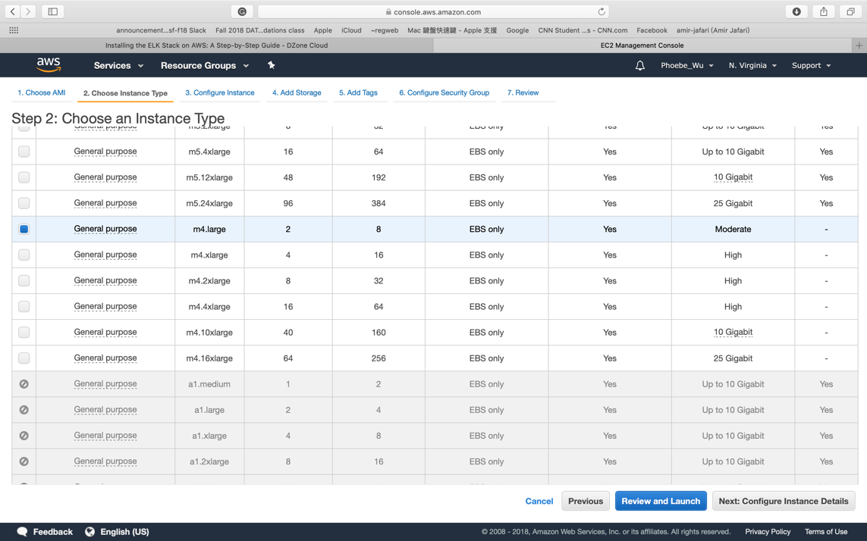
Set up AWS Instance

Slide 4
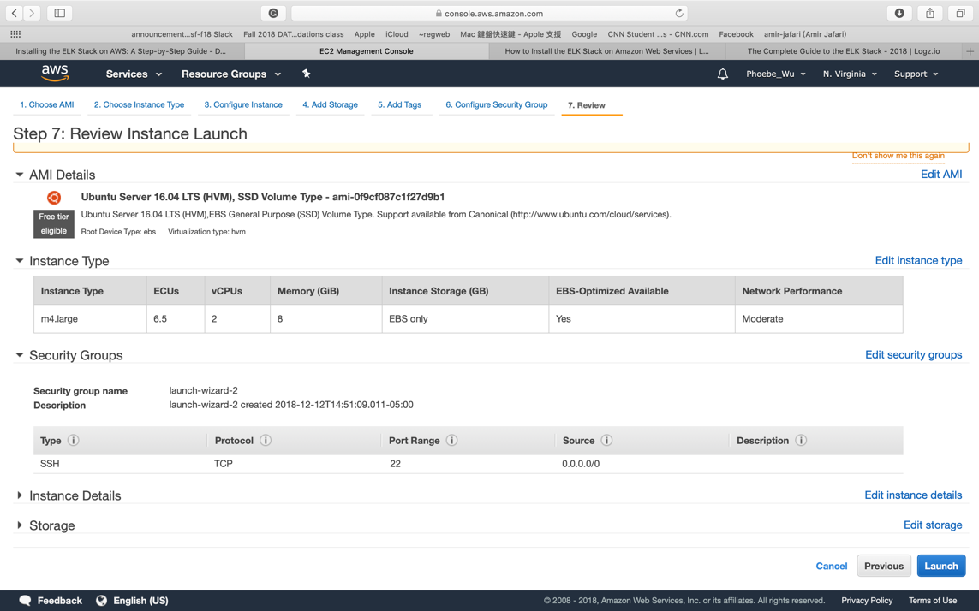
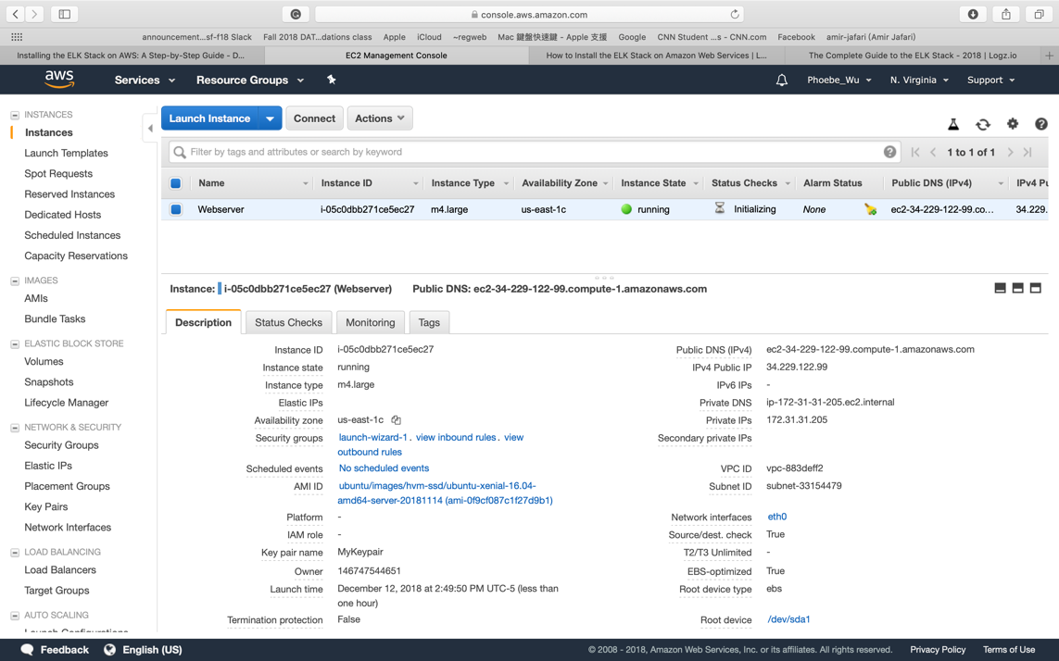

Slide 5
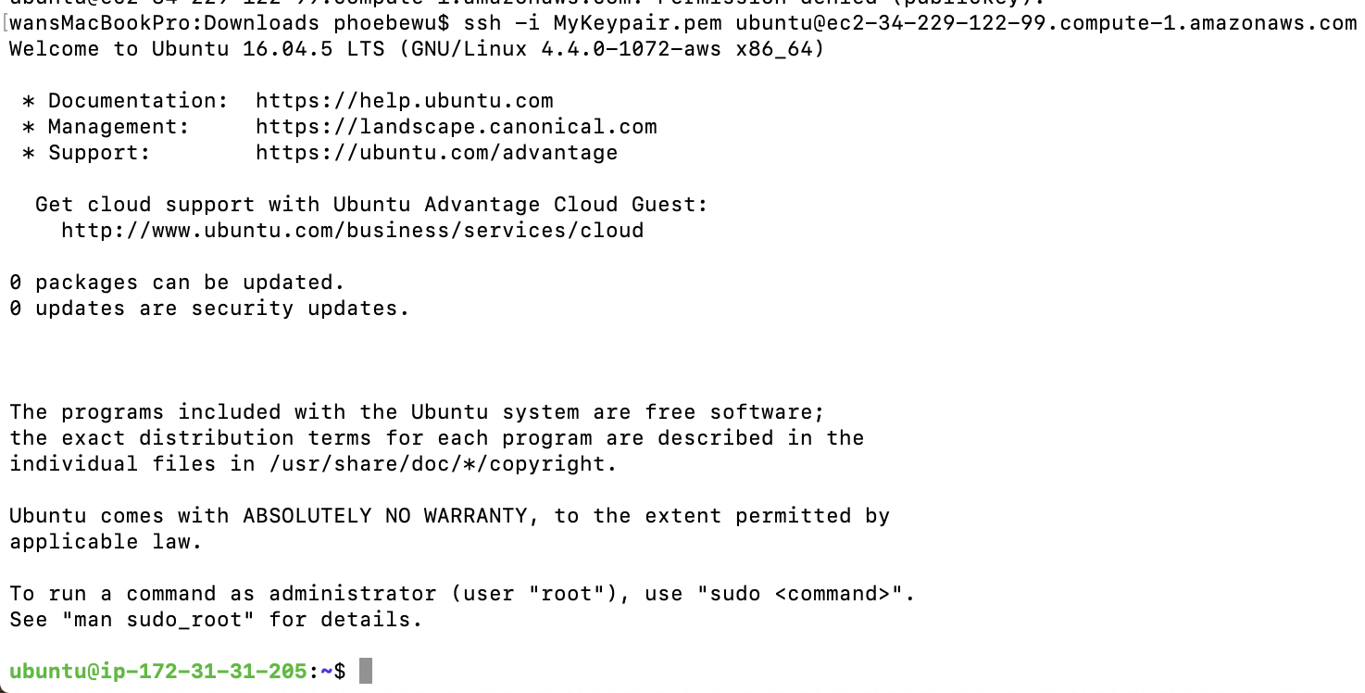
Login

Slide 6
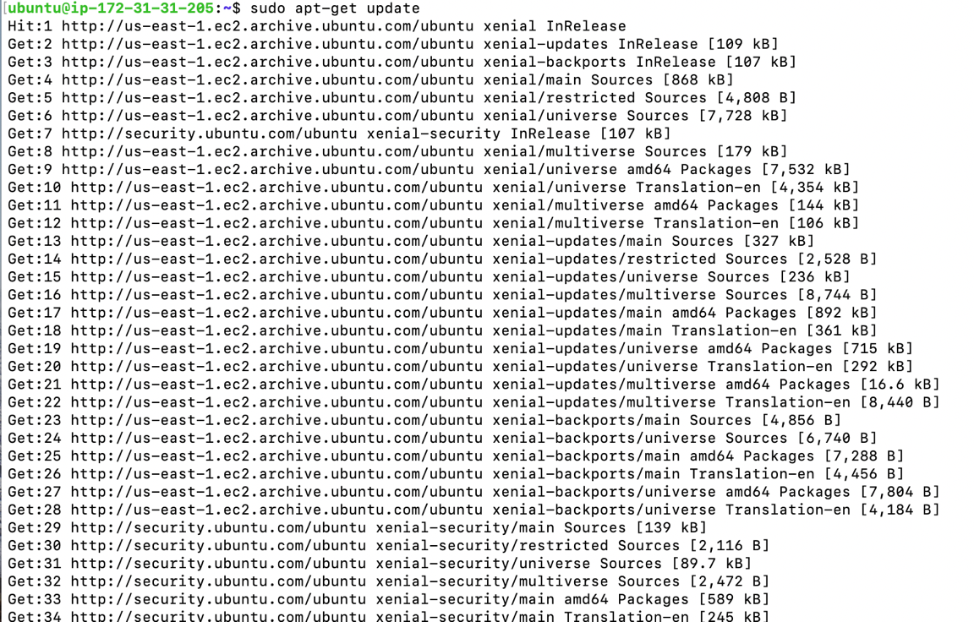
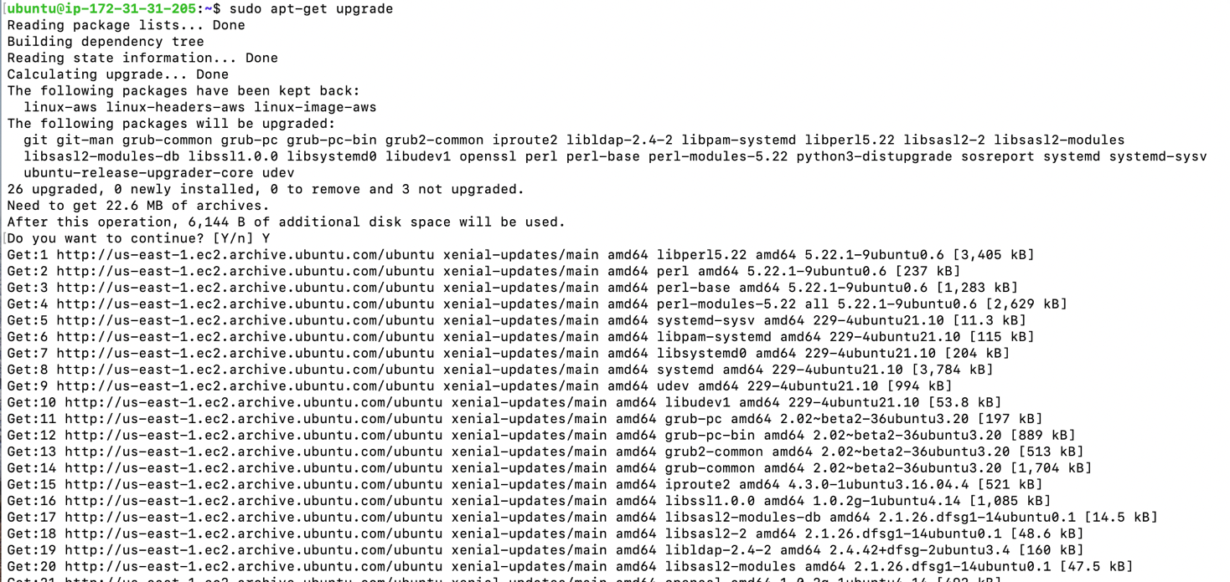
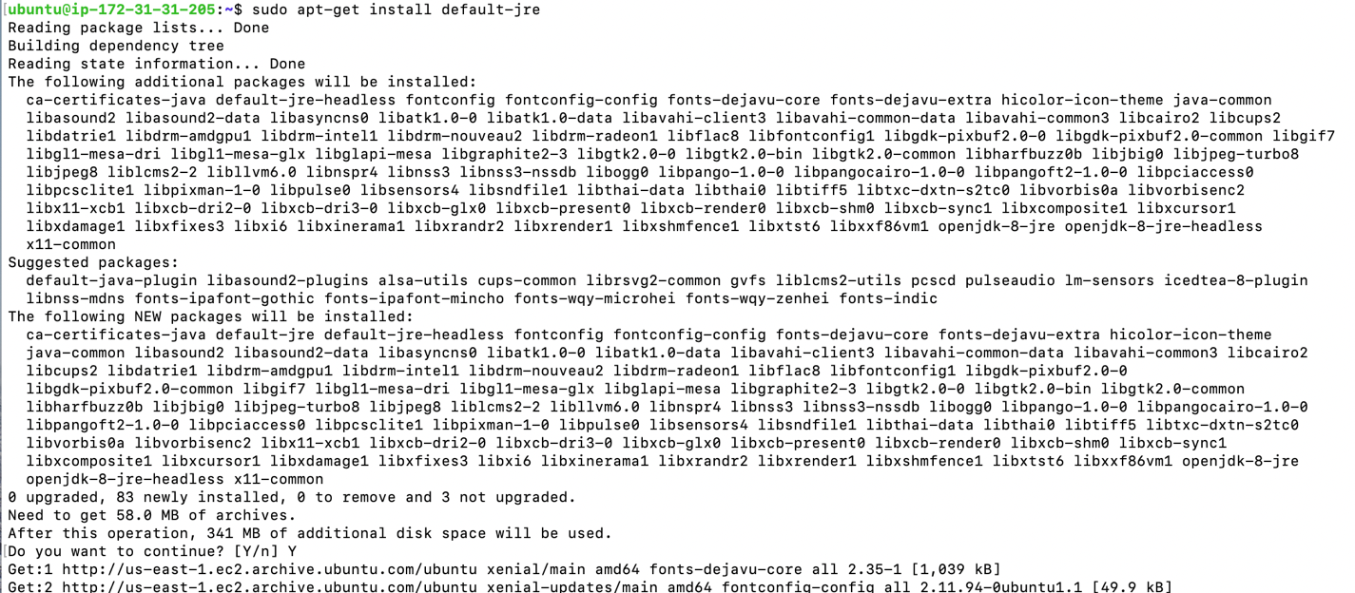
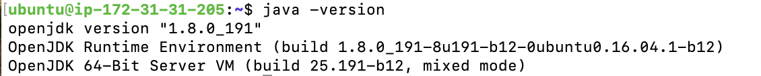
Package Installations & Install Java

Slide 7
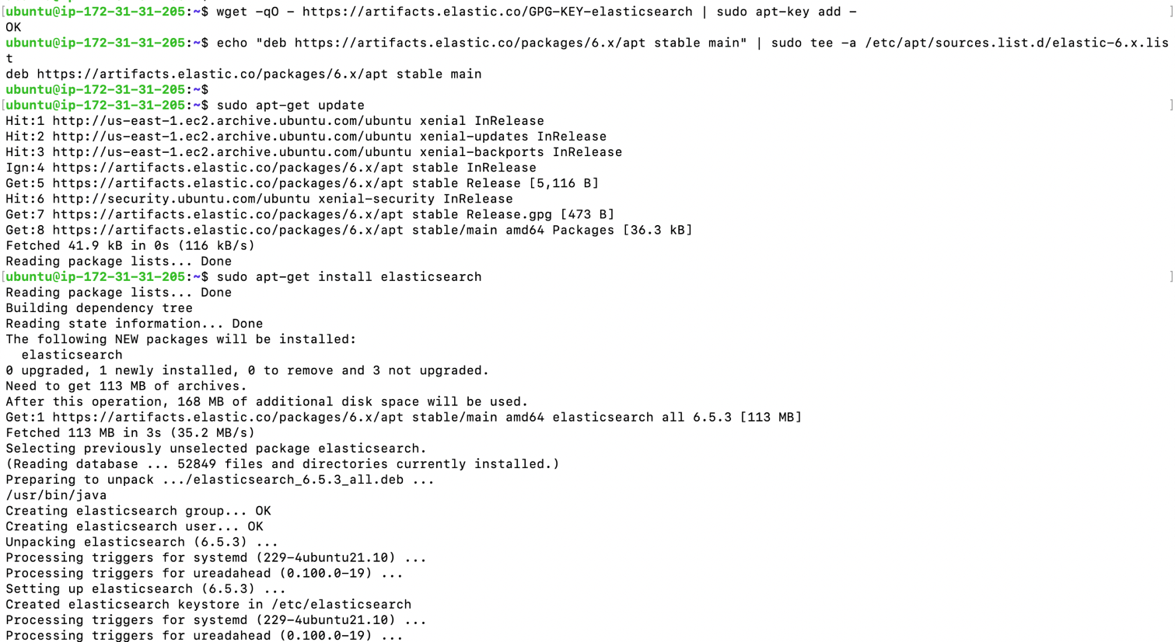
Elasticsearch Installation

Slide 8
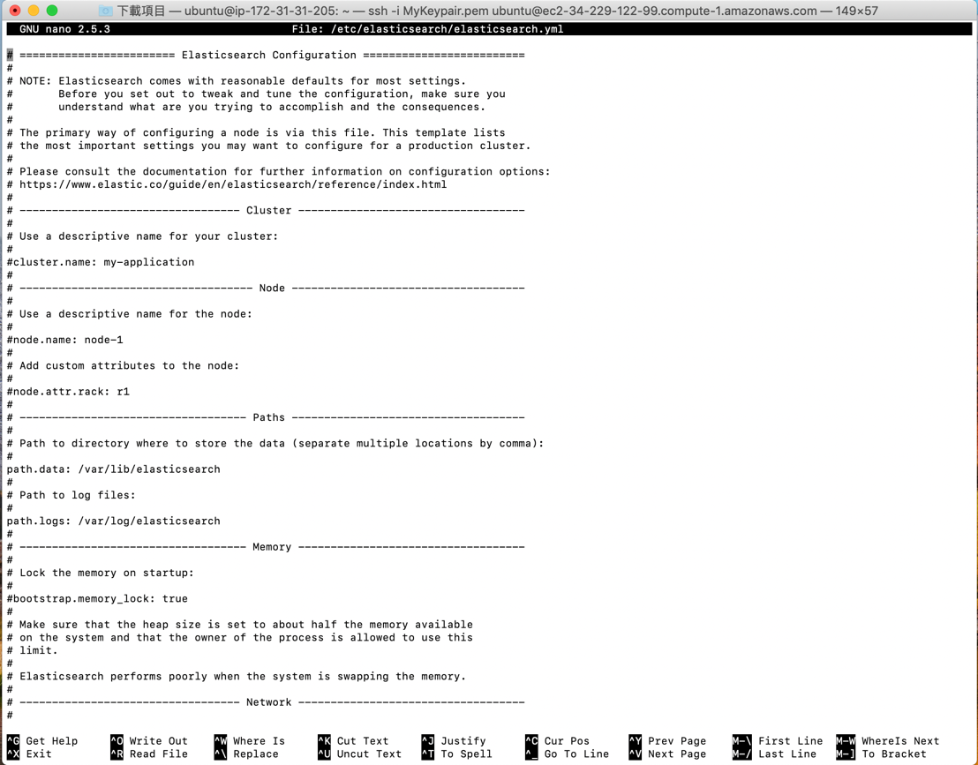
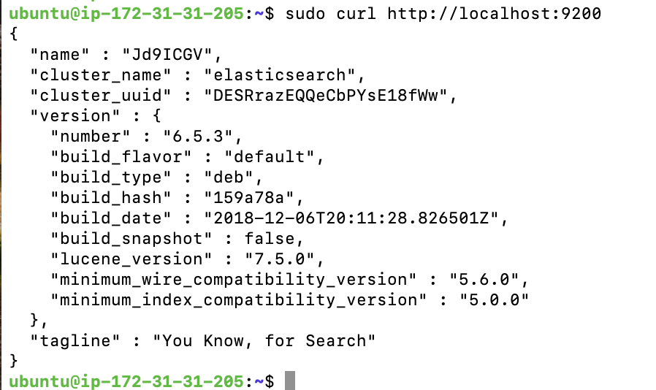
Elasticsearch configuration file
Elasticsearch Test:

Slide 9
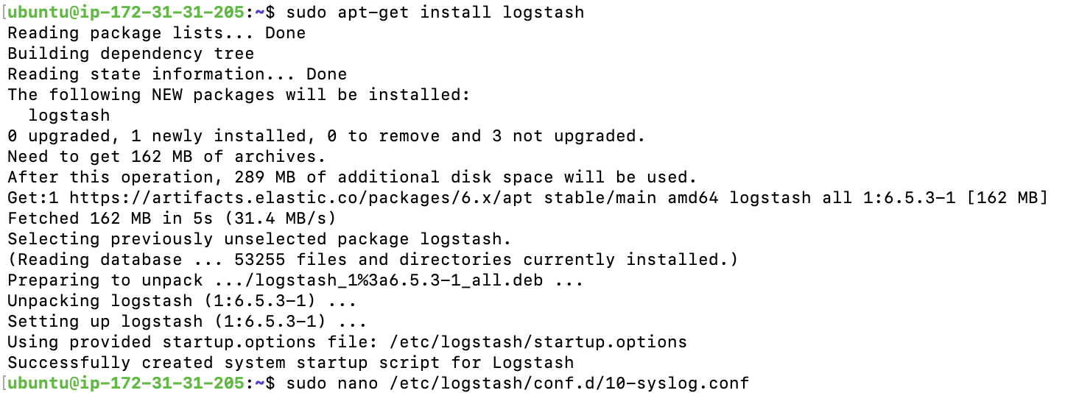
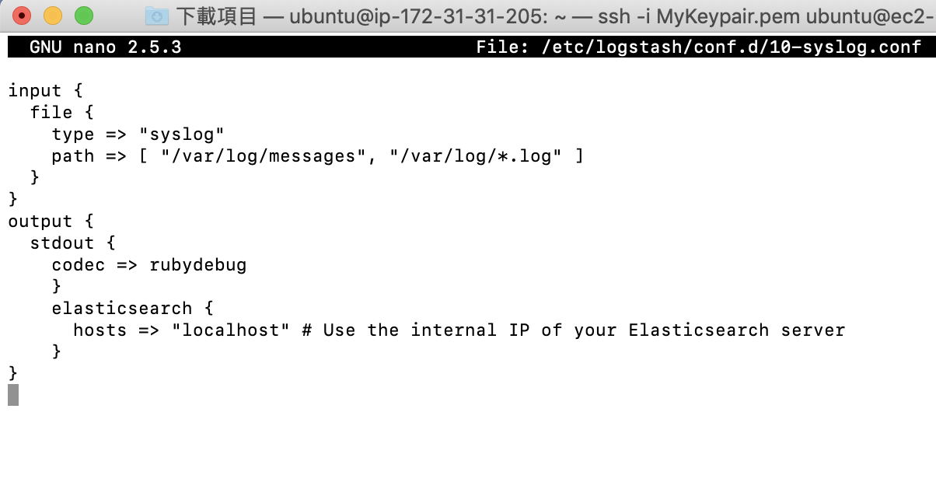
Logstash Installation
Create a Logstash configuration file

Slide 10
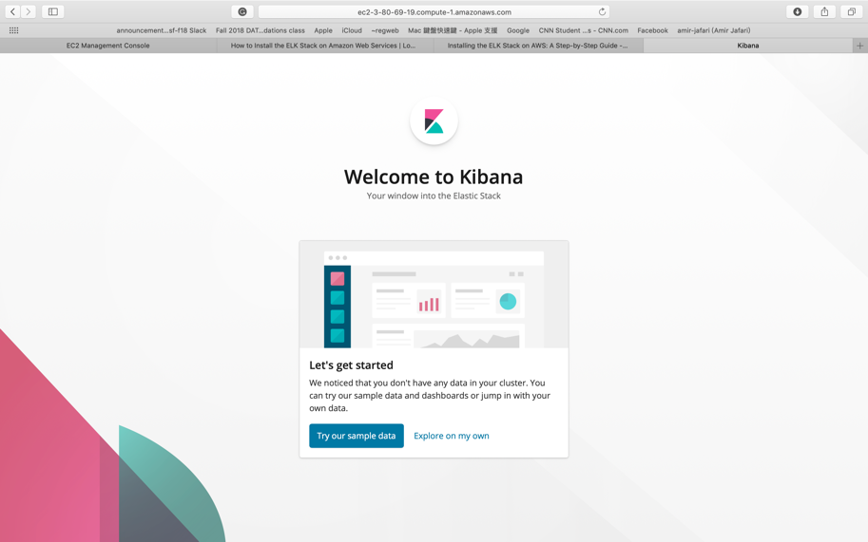
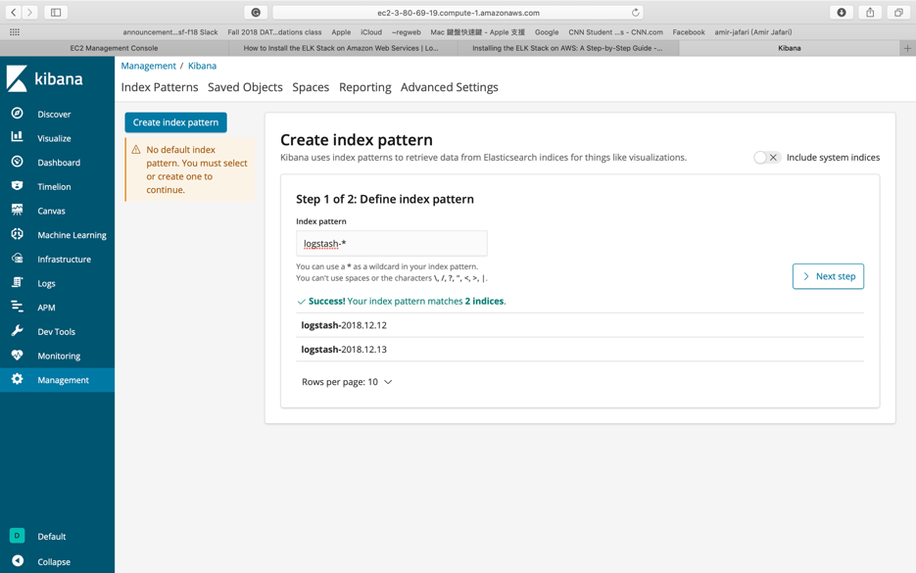
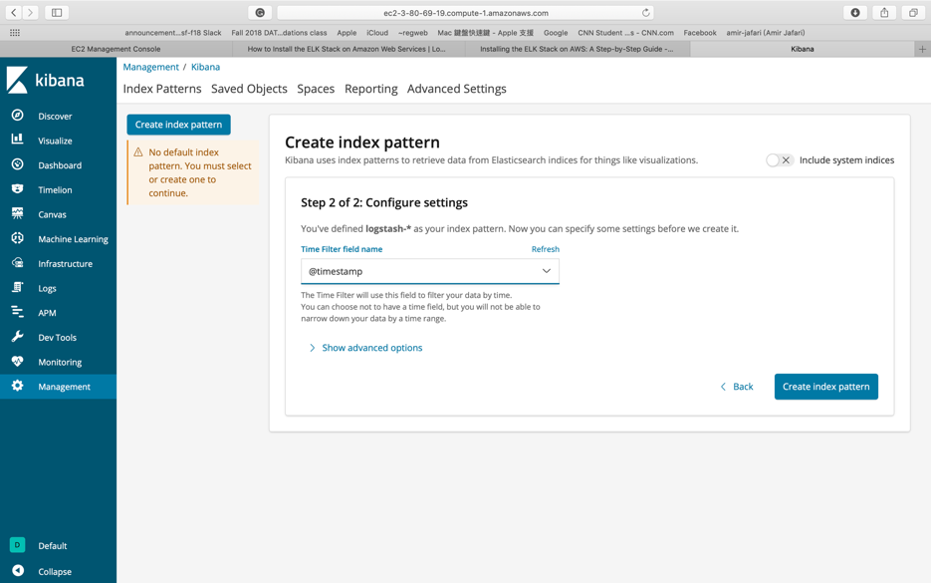
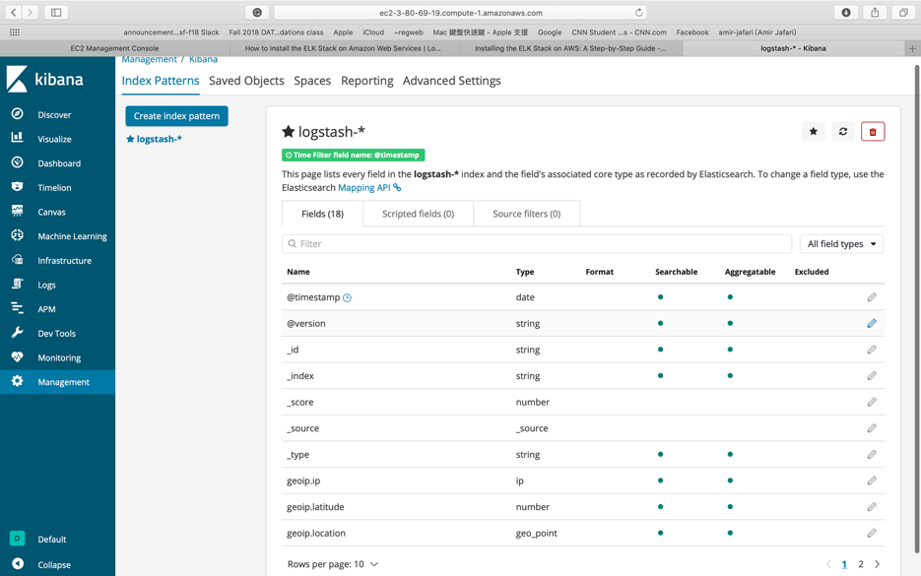
Login Kibana

Slide 11
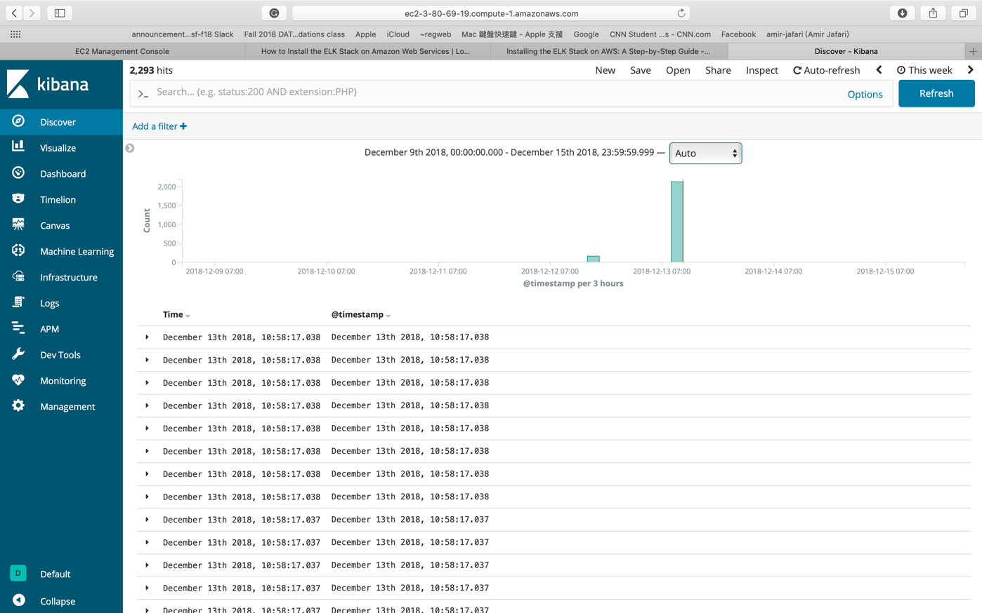
Kibana Graphics View

Slide 12
Part II

Slide 13
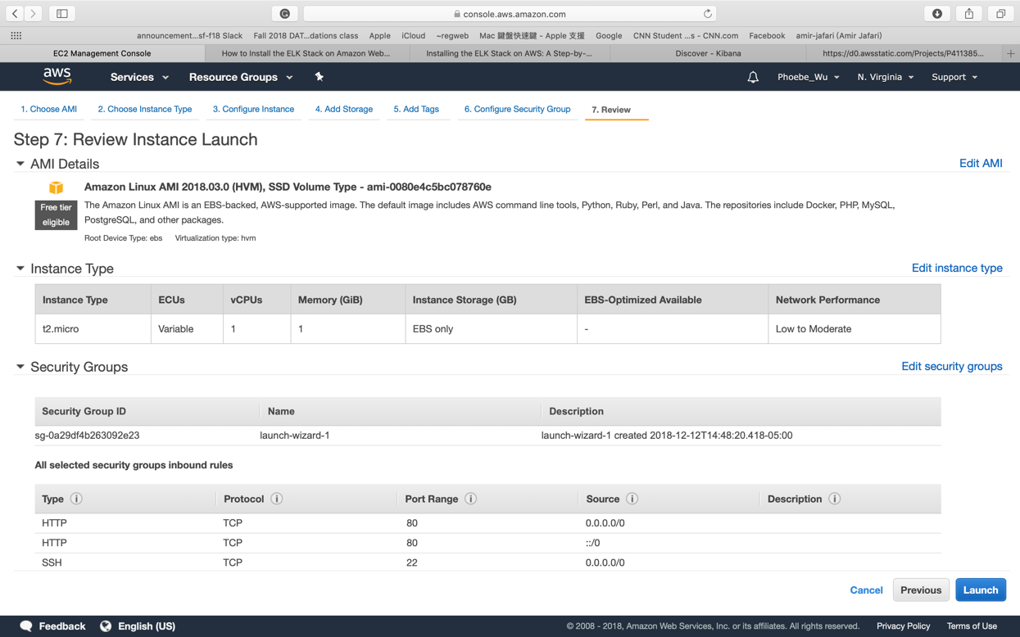
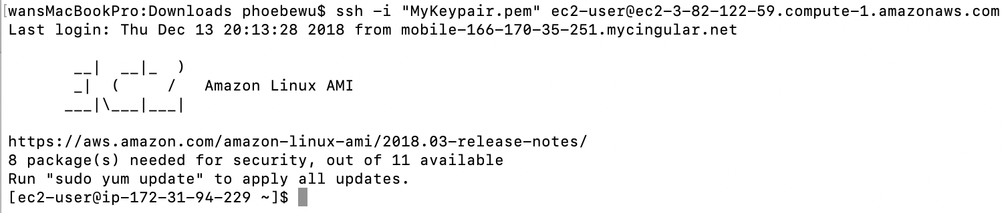
Start an EC2 Instance

Slide 14
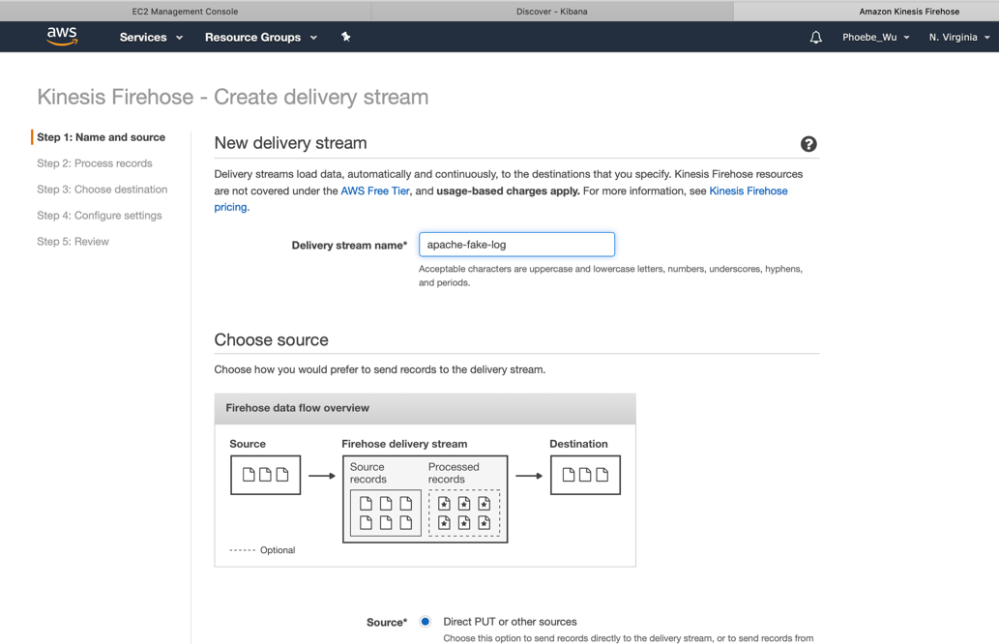
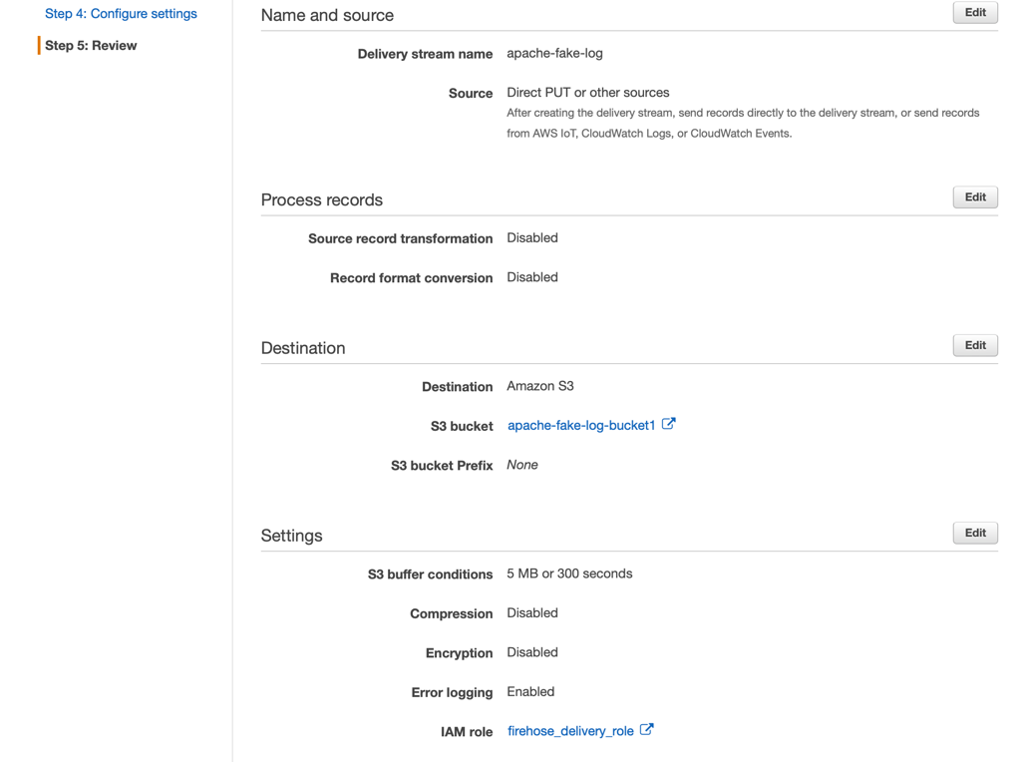
Firehose delivery streams

Slide 15
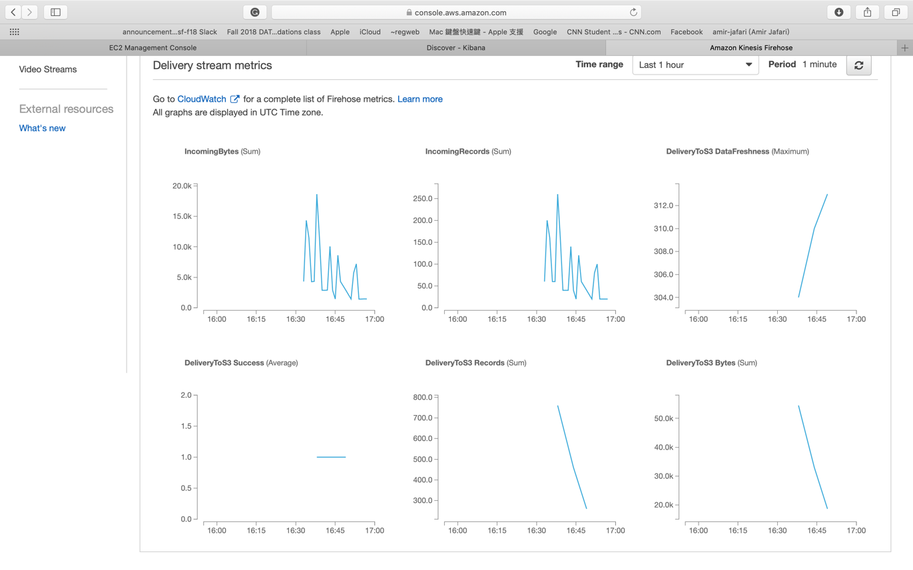
Test Firehose delivery streams with demo data

Slide 16
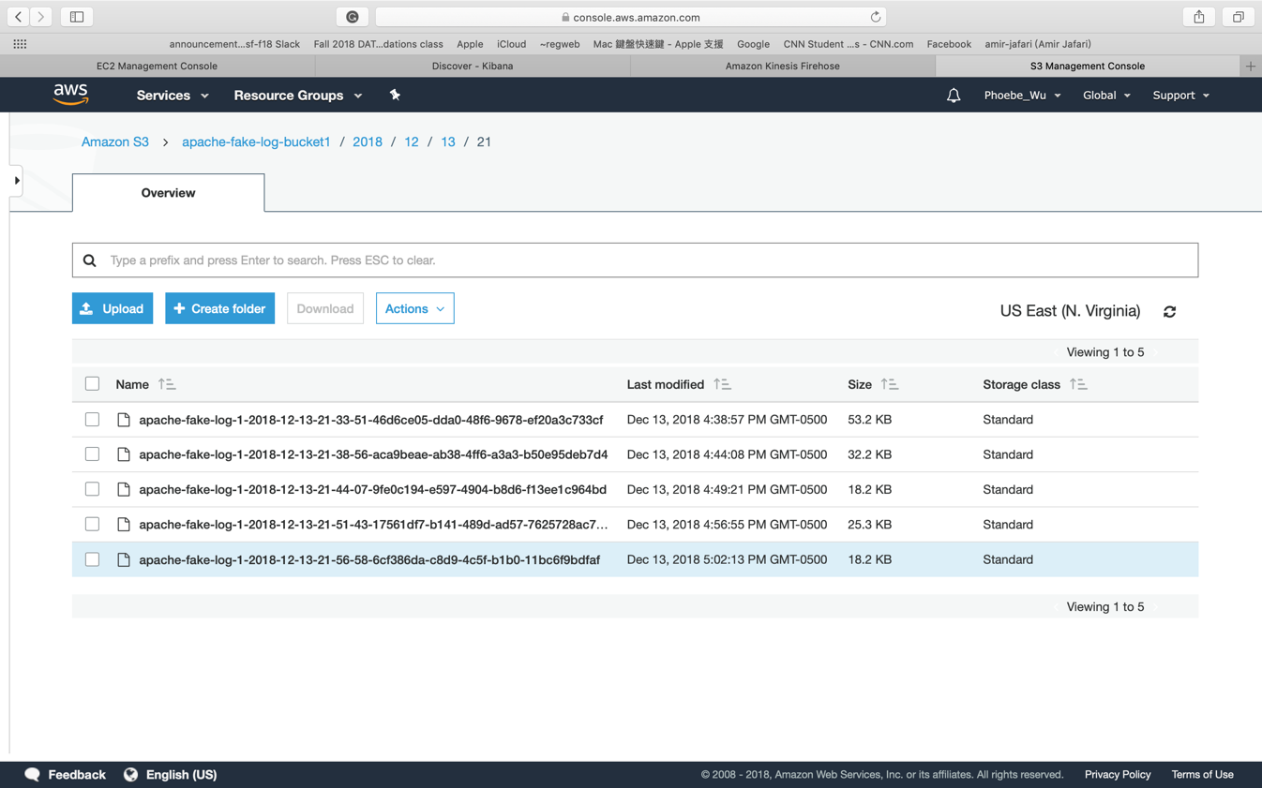
S3 bucket

Slide 17
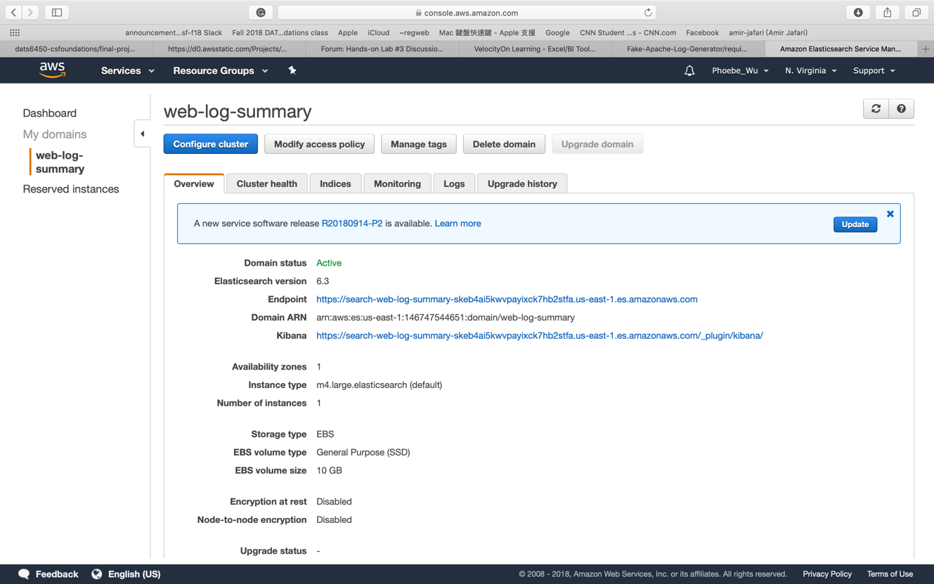
Create an Amazon Elasticsearch Service Domain

Slide 18
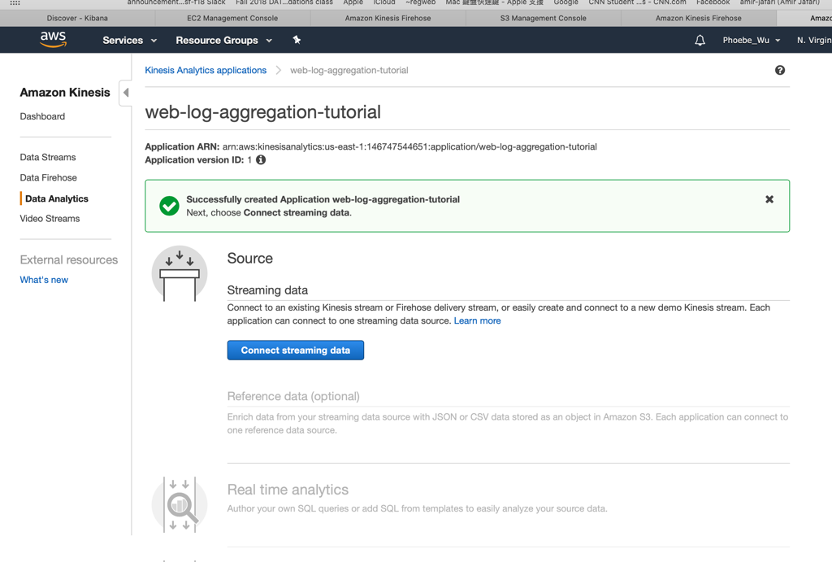
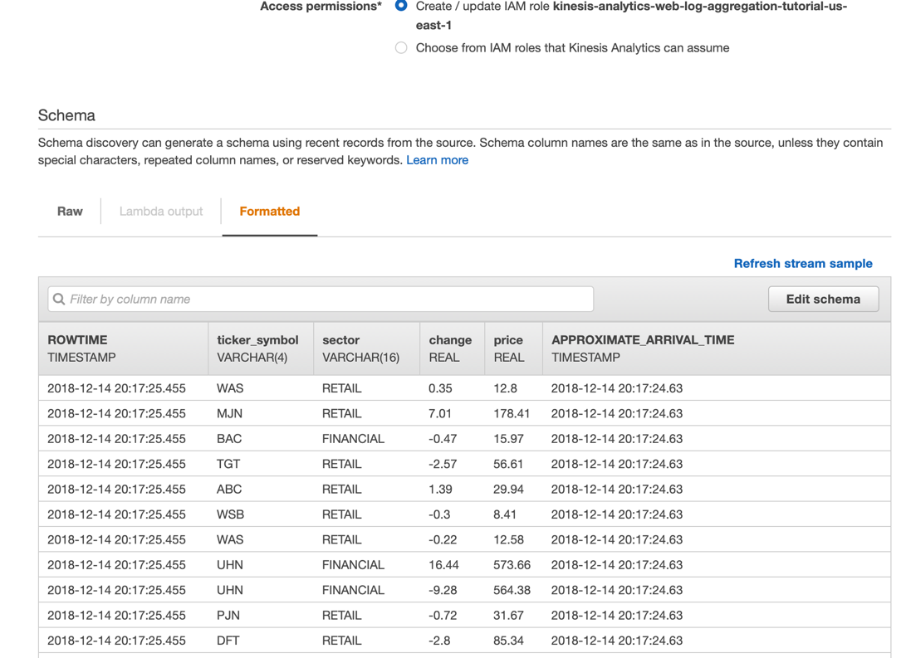
Create an Amazon Kinesis Analytics Application

Slide 19
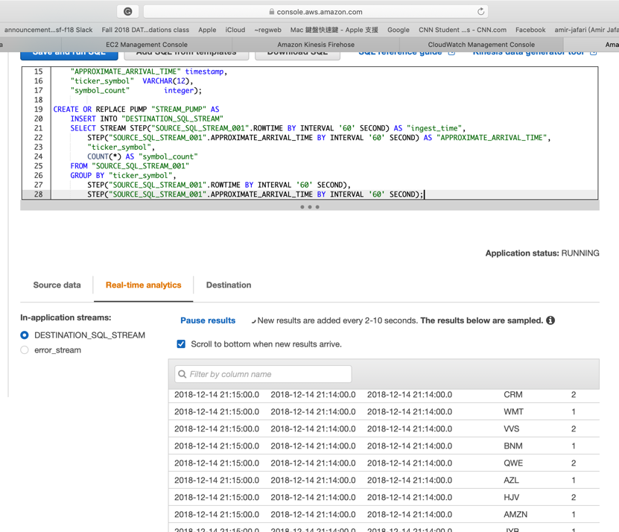
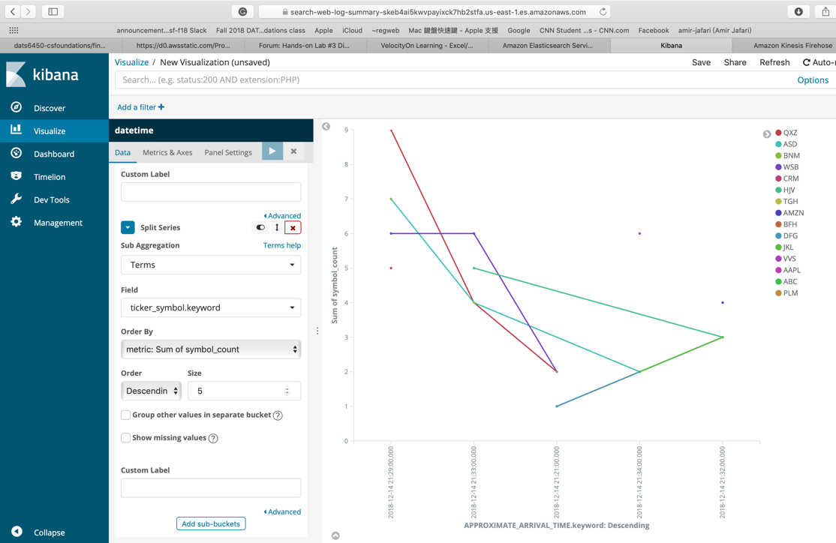
View the Aggregated Streaming Data

Slide 20
Part III

Slide 21
Dataset : Intrusion Detection Evaluation Dataset (CICIDS2017)
CICIDS2017 dataset contains benign and the most up-to-date common attacks, which resembles the true real-world data (PCAPs).
It also includes the results of the network traffic analysis using CICFlowMeter with labeled flows based on the time stamp, source and destination IPs, source and destination ports, protocols and attack (CSV files)
The data: Thursday July 6, 2017, Morning

Slide 22
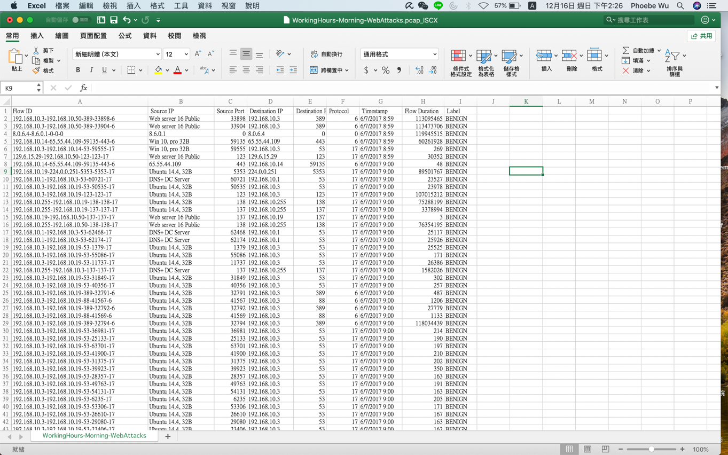
Dataset after cleaning

Slide 23
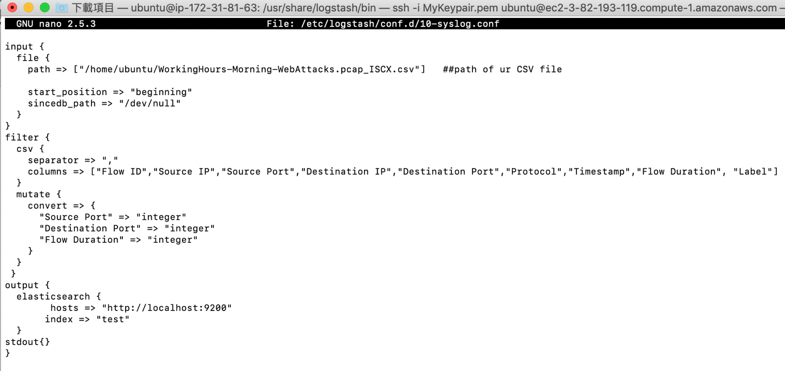
Logstash configuration file

Slide 24
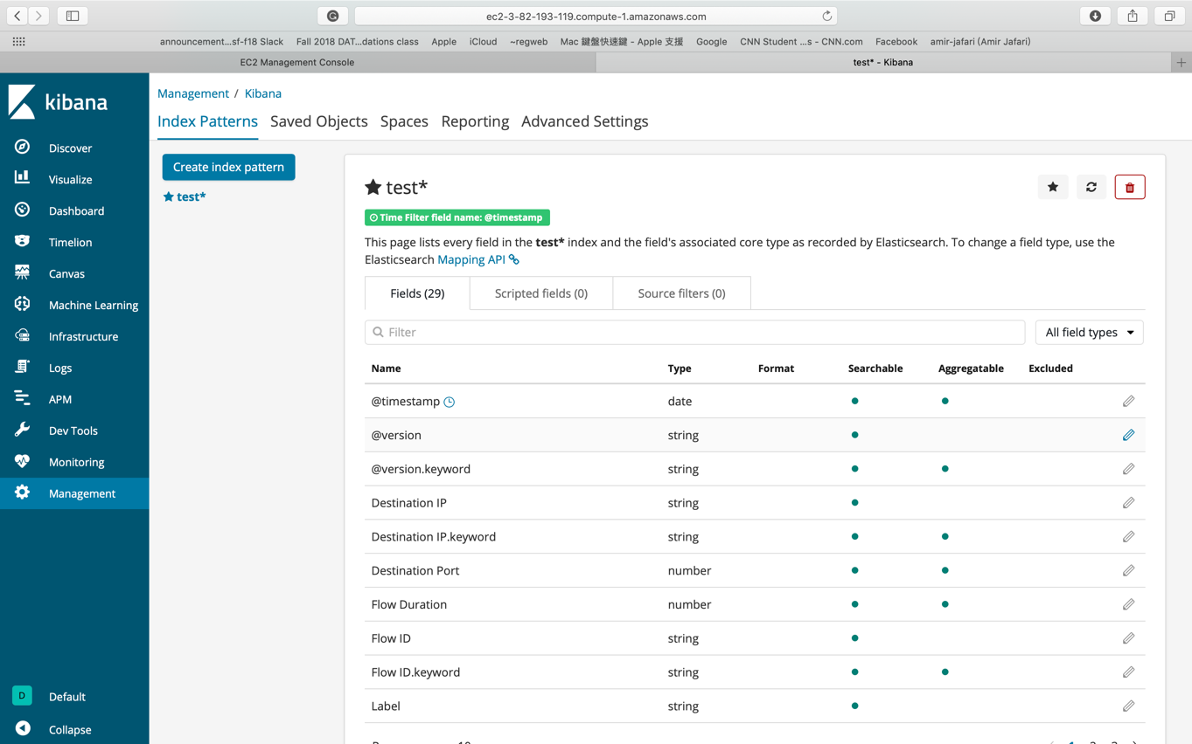
Kibana

Slide 25
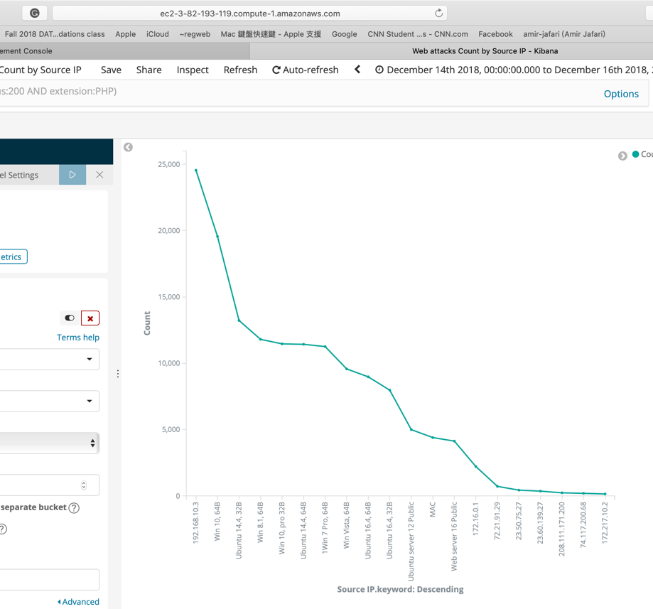
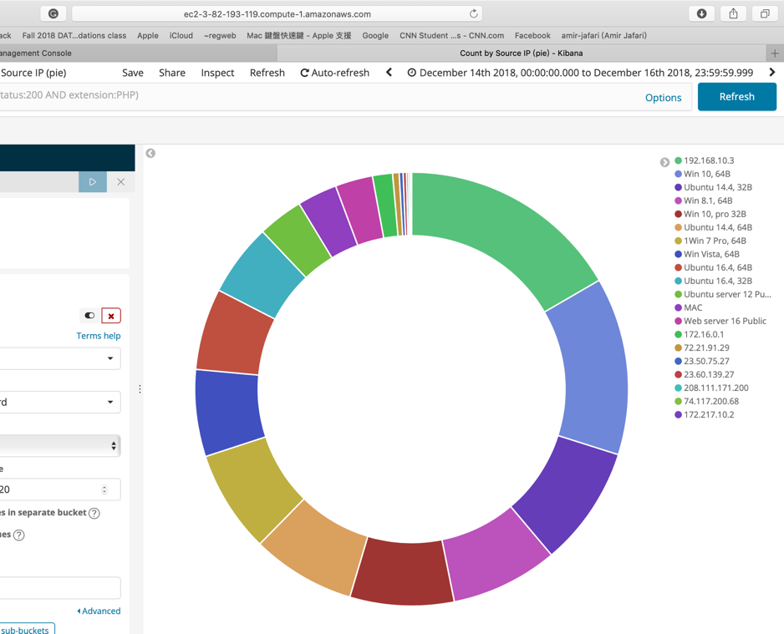
Web attacks Count by Source IP
The plots show that at IP 192.168.10.3 (DNS+ DC Server) get the most attacks.

Slide 26
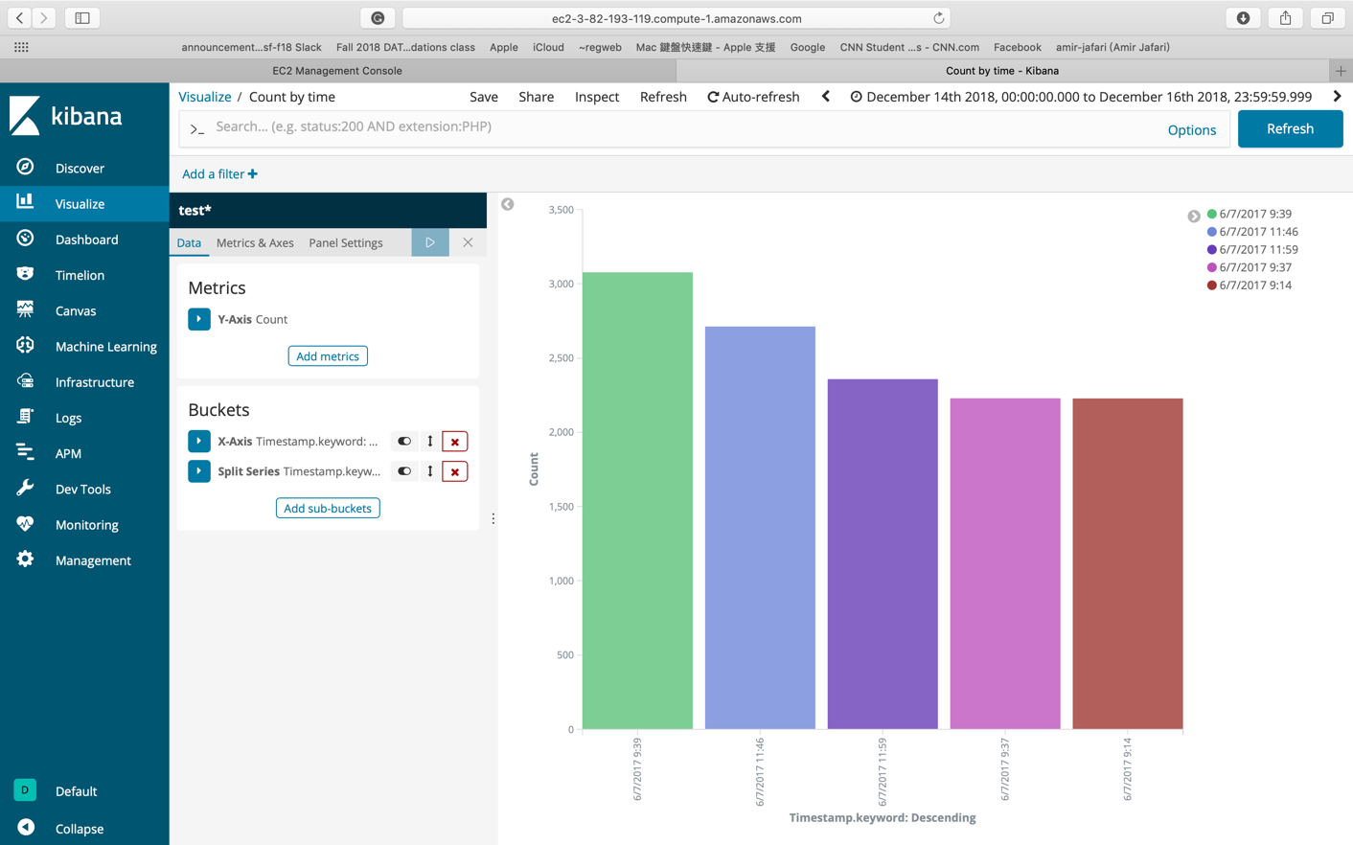
Web Attacks Count by Time (Top 5)
In the plot, the web attack happens more at 9 and 11 am

Slide 27
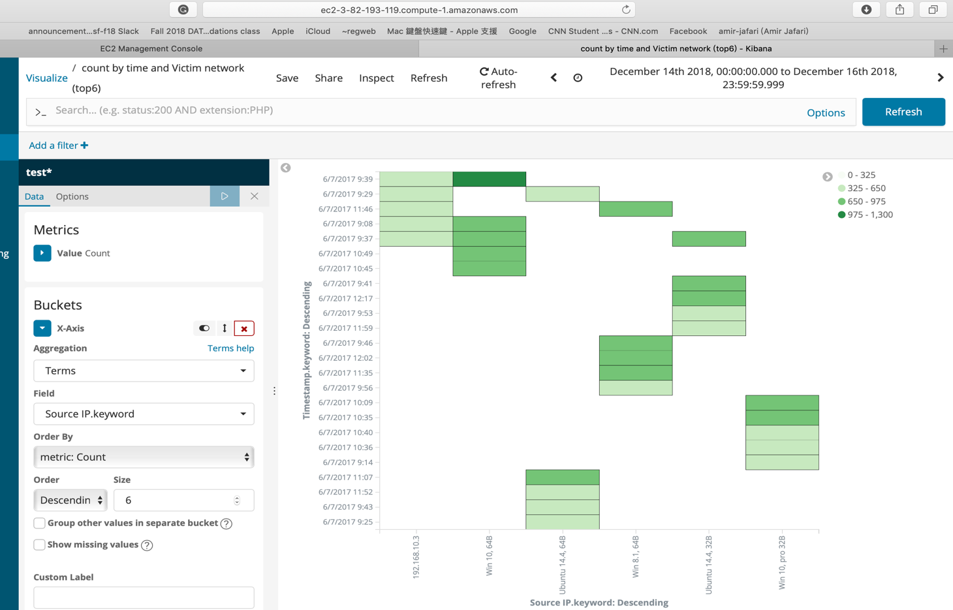
Count by time and Source IP (Top 6)
DNS+ DC Server: 192.168.10.3

Slide 28
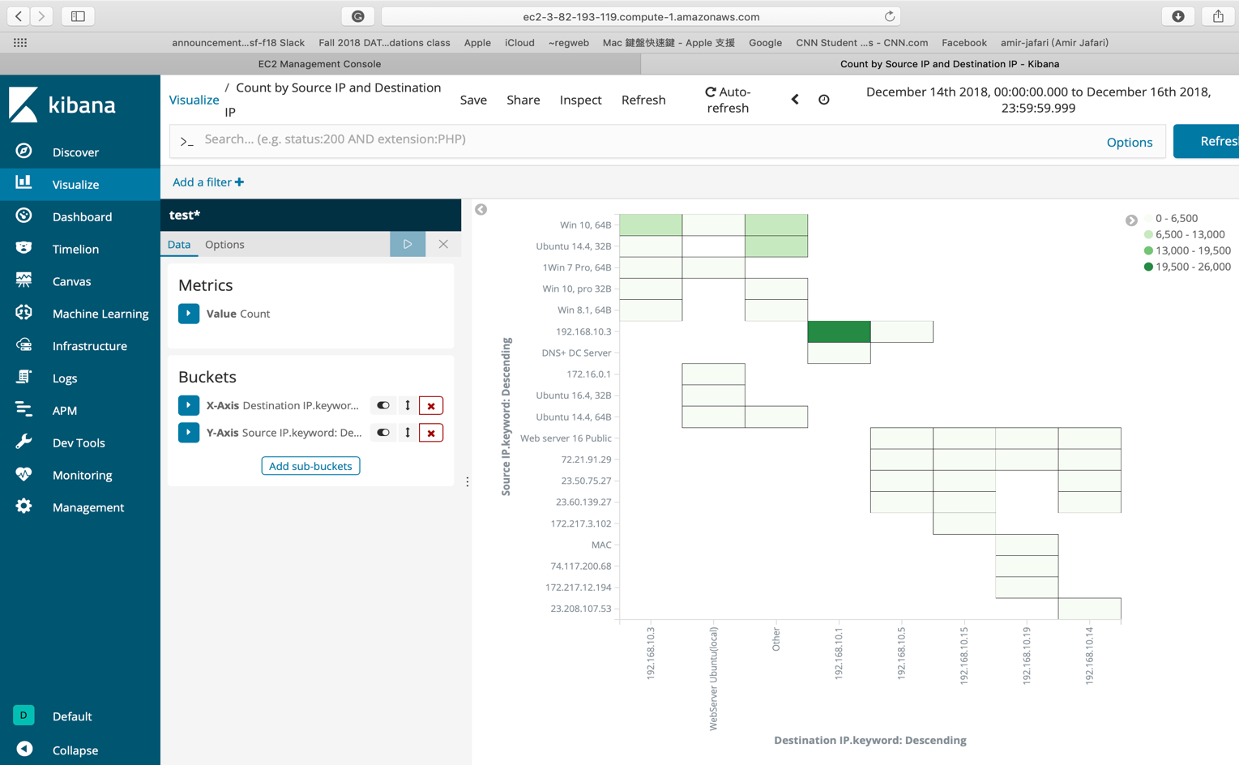
Count by Source IP and Destination IP

Slide 29
Thank You

